Slide 1
Learning by Computing Distances (2): Wrapping-up LwP, Nearest Neighbors
CSN-382

Slide 2



LwP: The Prediction Rule, Mathematically
What does the prediction rule for LwP look like mathematically?
Assume we are using Euclidean distances here
$${\left|\left|μ_{−}−x\right|\right|}^{2}={\left|\left|μ_{−}\right|\right|}^{2}+{\left|\left|x\right|\right|}^{2}−2\left\langle μ_{−},x\right\rangle$$
$$μ_{−}$$
$$μ_{+}$$
$${\left|\left|μ_{+}−x\right|\right|}^{2}={\left|\left|μ_{+}\right|\right|}^{2}+{\left|\left|x\right|\right|}^{2}−2\left\langle μ_{+},x\right\rangle$$
Test example $x$
Prediction Rule: Predict label as +1 if $f\left(x\right)={\left|\left|μ_{−}−x\right|\right|}^{2}$ $−$ ${\left|\left|μ_{+}−x\right|\right|}^{2}>0$ otherwise -1

Slide 3


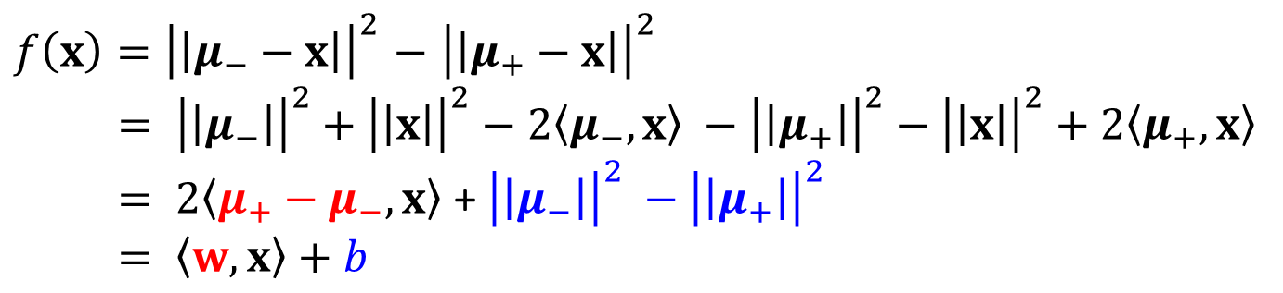
LwP: The Prediction Rule, Mathematically
Let’s expand the prediction rule expression a bit more
Thus LwP with Euclidean distance is equivalent to a linear model with
Weight vector $w=$2($μ_{+}−μ_{−})$
Bias term $b={\left|\left|μ_{−}\right|\right|}^{2} −{\left|\left|μ_{+}\right|\right|}^{2}$
Prediction rule therefore is: Predict +1 if $\left\langle w,x\right\rangle +b$ > 0, else predict -1
$f\left(x\right)={\left|\left|μ_{−}−x\right|\right|}^{2}$ $−$ ${\left|\left|μ_{+}−x\right|\right|}^{2}$
$= {\left|\left|μ_{−}\right|\right|}^{2}+{\left|\left|x\right|\right|}^{2}−2\left\langle μ_{−},x\right\rangle −{\left|\left|μ_{+}\right|\right|}^{2}−{\left|\left|x\right|\right|}^{2}+2\left\langle μ_{+},x\right\rangle$
$= 2\left\langle μ_{+}−μ_{−},x\right\rangle$ + ${\left|\left|μ_{−}\right|\right|}^{2} −{\left|\left|μ_{+}\right|\right|}^{2}$
$= \left\langle w,x\right\rangle +b$
Will look at linear models more formally and in more detail later

Slide 4


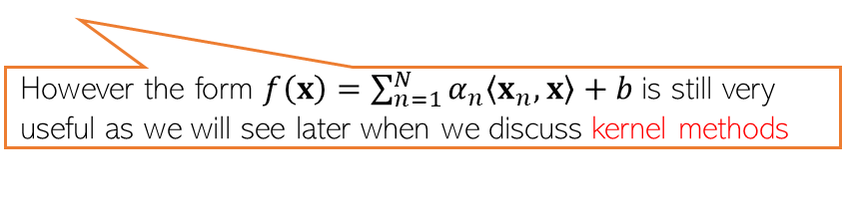
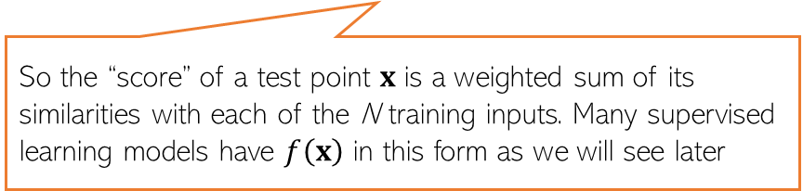

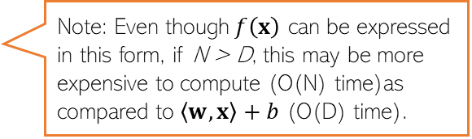
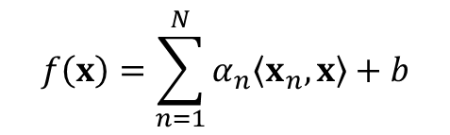

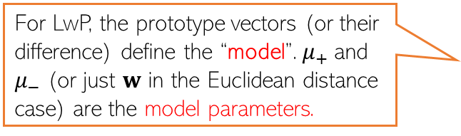



Learning with Prototypes (LwP)
$$μ_{−}= \frac{1}{N_{−}}\sum_{y_{n}=−1}{x_{n}}$$
$$μ_{+}= \frac{1}{N_{+}}\sum_{y_{n}=+1}{x_{n}}$$
$$μ_{−}$$
$$μ_{+}$$
$$w$$
$$w=μ_{+} −μ_{−}$$
Prediction rule for LwP (for binary classification with Euclidean distance)
If Euclidean distance used
$f\left(x\right)= 2\left\langle μ_{+}−μ_{−},x\right\rangle$ + ${\left|\left|μ_{−}\right|\right|}^{2} −{\left|\left|μ_{+}\right|\right|}^{2}= \left\langle w,x\right\rangle +b$
For LwP, the prototype vectors (or their difference) define the “model”. $μ_{+}$and $μ_{−}$ (or just $w$ in the Euclidean distance case) are the model parameters.
Decision boundary
(perpendicular bisector of line joining the class prototype vectors)
($f\left(x\right)$> 0 then predict +1 otherwise -1)
Exercise: Show that for the bin. classfn case
$$f\left(x\right)=\sum_{n=1}^{N}{α_{n}\left\langle x_{n},x\right\rangle +b}$$
Note: Even though$f\left(x\right)$ can be expressed in this form, if N > D, this may be more expensive to compute (O(N) time)as compared to $\left\langle w,x\right\rangle +b$ (O(D) time).
Can throw away training data after computing the prototypes and just need to keep the model parameters for the test time in such “parametric” models
So the “score” of a test point $x$ is a weighted sum of its similarities with each of the N training inputs. Many supervised learning models have $f\left(x\right)$ in this form as we will see later
However the form $f\left(x\right)=\sum_{n=1}^{N}{α_{n}\left\langle x_{n},x\right\rangle +b}$is still very useful as we will see later when we discuss kernel methods

Slide 5
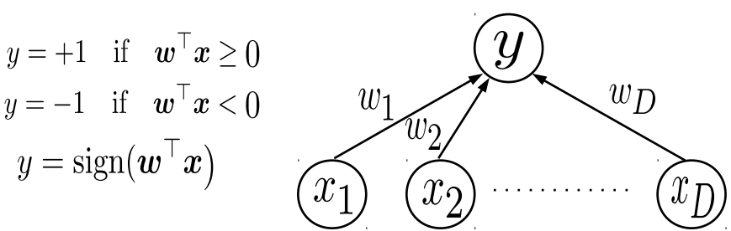

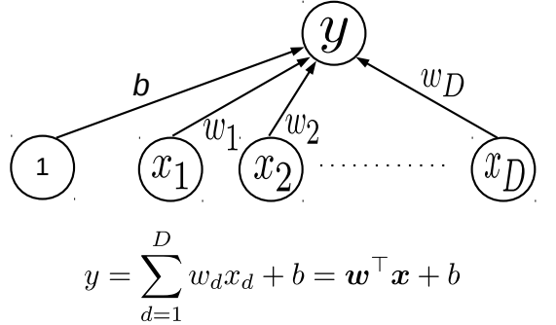
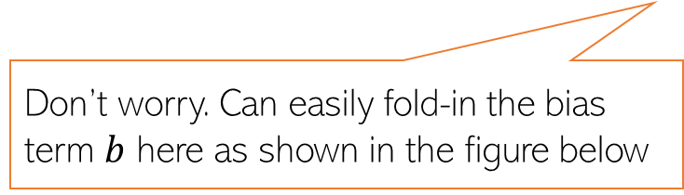

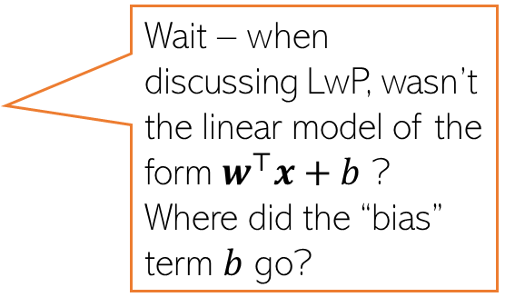
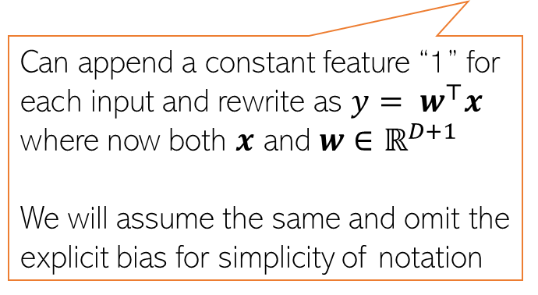
Linear Models
5
A linear model $y= w^{⊤}x$ can also be used in classification problems
For Binary Classification, can treat $w^{⊤}x$ as the “score” of input $x$ and threshold to get binary label
Recall that the LwP model can also be seen as a linear model (although it wasn’t formulated like this)
Don’t worry. Can easily fold-in the bias term $b$ here as shown in the figure below
Wait – when discussing LwP, wasn’t the linear model of the form $w^{⊤}x+b$ ? Where did the “bias” term $b$ go?
Can append a constant feature “1” for each input and rewrite as $y= w^{⊤}x$ where now both $x$ and $w∈$ $ℝ^{D+1}$
We will assume the same and omit the explicit bias for simplicity of notation

Slide 6
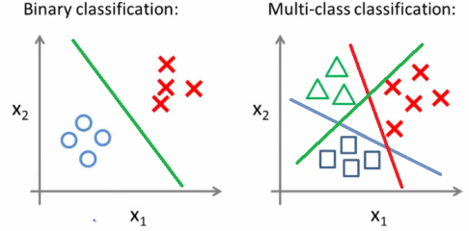
Multi-class Classification
Multi-class Classification: A classification task with more than two classes; e.g., classify a set of images of fruits which may be oranges, apples, or pears. Multi-class classification makes the assumption that each sample is assigned to one and only one label: a fruit can be either an apple or a pear but not both at the same time.
Binary Classification: Classification tasks with two classes.
Multi-class Classification: Classification tasks with more than two classes.
Some algorithms are designed for binary classification problems.
Examples include:
Logistic Regression
Perceptron
Support Vector Machines

Slide 7
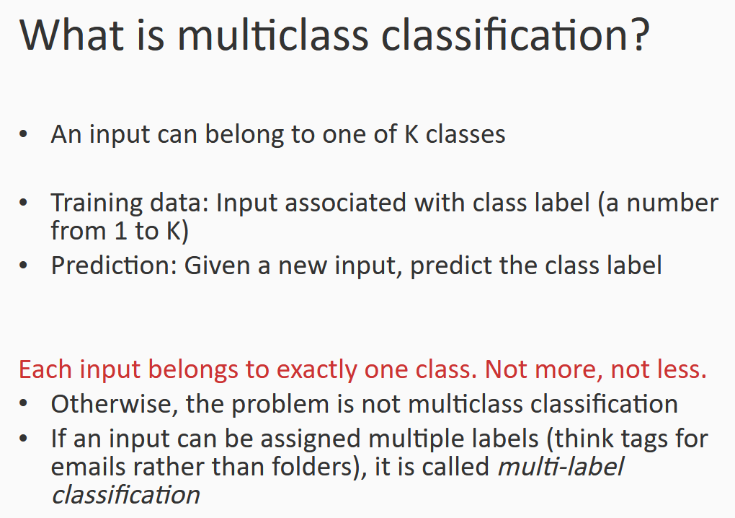

Slide 8
One-Vs-Rest for Multi-Class Classification
One-vs-rest (OvR for short, also referred to as One-vs-All or OvA) is a heuristic method for using binary classification algorithms for multi-class classification.
It involves splitting the multi-class dataset into multiple binary classification problems. A binary classifier is then trained on each binary classification problem and predictions are made using the model that is the most confident.
For example, given a multi-class classification problem with examples for each class ‘red,’ ‘blue,’ and ‘green‘. This could be divided into three binary classification datasets as follows:
Binary Classification Problem 1: red vs [blue, green]
Binary Classification Problem 2: blue vs [red, green]
Binary Classification Problem 3: green vs [red, blue]
A possible downside of this approach is that it requires one model to be created for each class. For example, three classes requires three models.

Slide 9
One-Vs-Rest for Multi-Class Classification

Slide 10
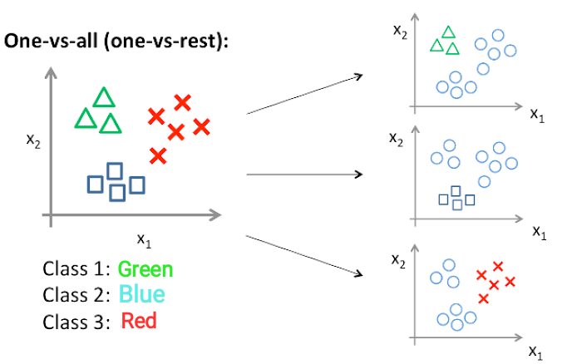
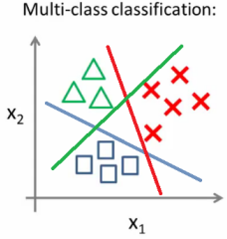
One-Vs-Rest for Multi-Class Classification

Slide 11
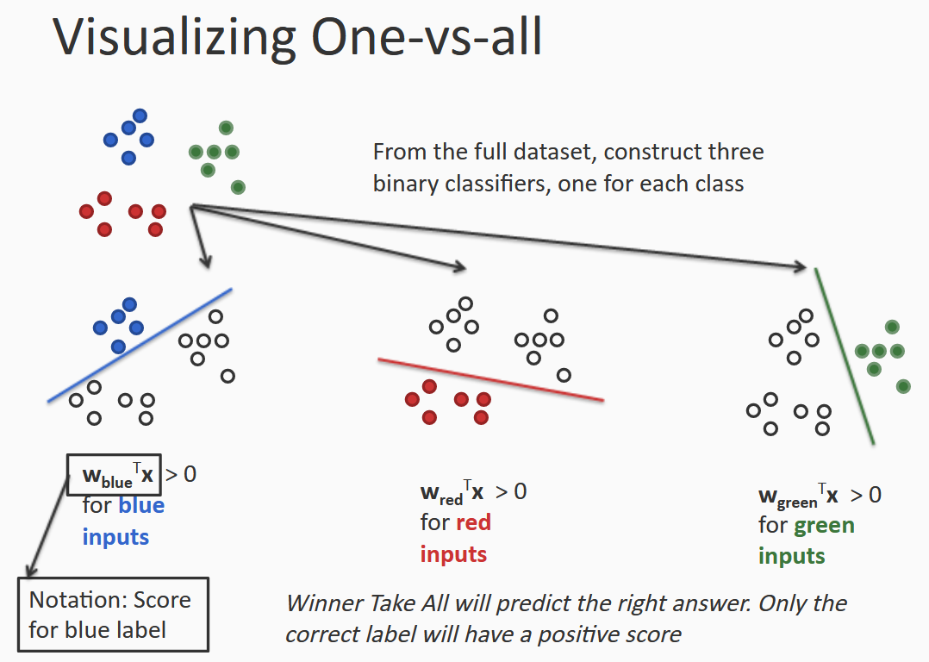

Slide 12
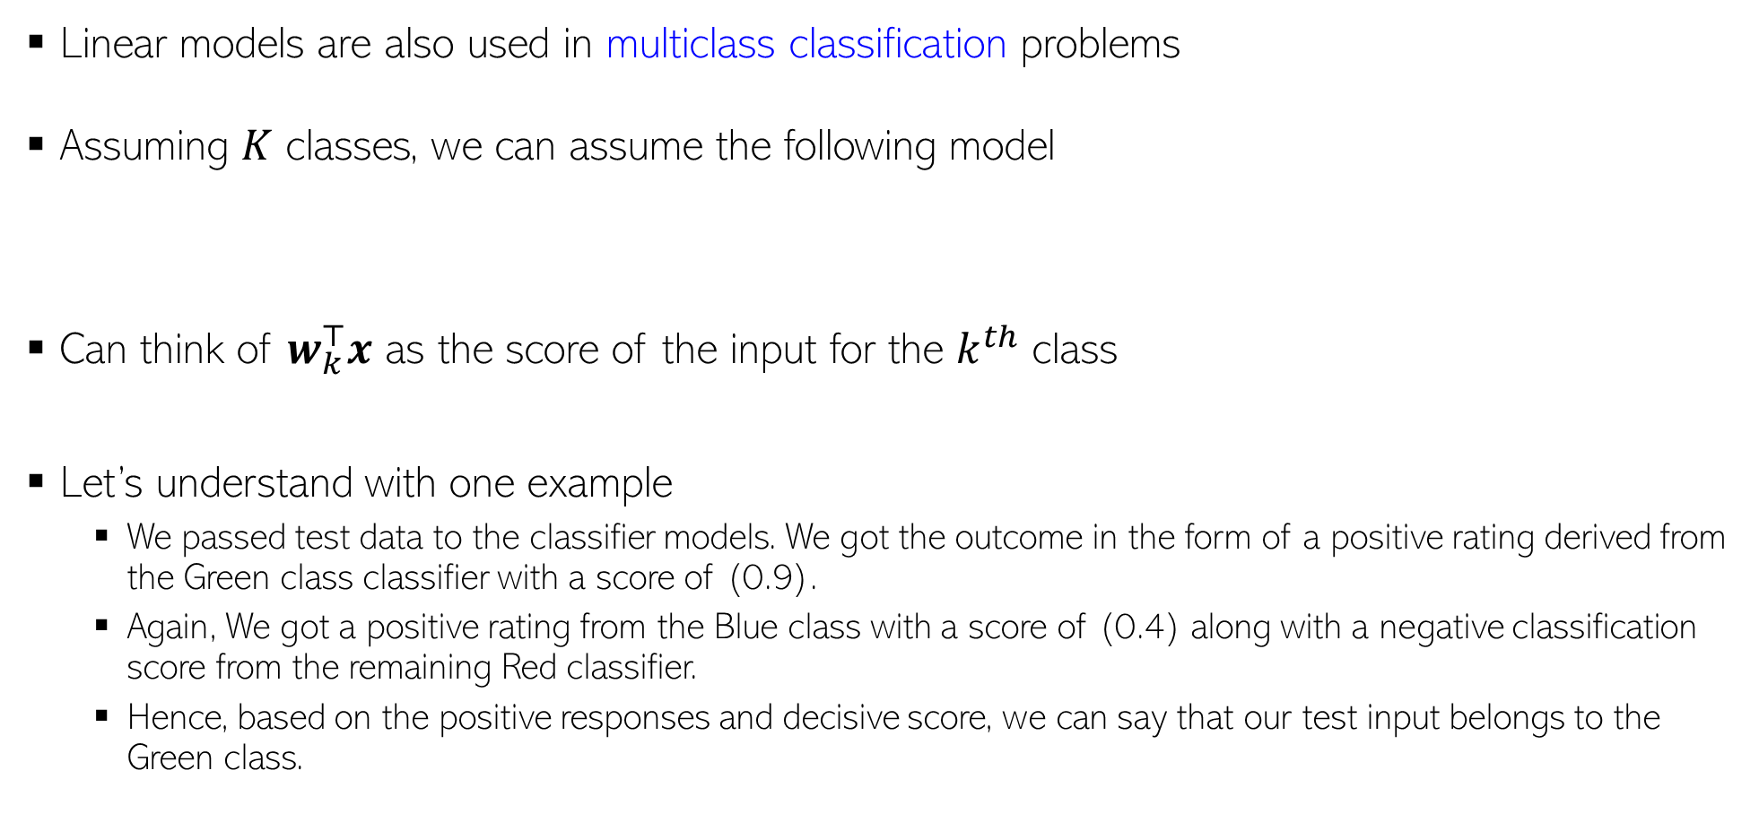

Linear Models
12
Linear models are also used in multiclass classification problems
Assuming $K$ classes, we can assume the following model
Can think of $w_{k}^{⊤}x$ as the score of the input for the $k^{th}$ class
Let’s understand with one example
We passed test data to the classifier models. We got the outcome in the form of a positive rating derived from the Green class classifier with a score of (0.9).
Again, We got a positive rating from the Blue class with a score of (0.4) along with a negative classification score from the remaining Red classifier.
Hence, based on the positive responses and decisive score, we can say that our test input belongs to the Green class.
$$y= {argmax}_{k∈\{1,2,…,K\}} w_{k}^{⊤}x$$

Slide 13
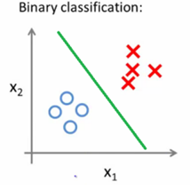
Decision Boundary
The Decision Boundary separates the data-points into regions, which are actually the classes in which they belong.
In a statistical-classification problem with two classes, a decision boundary or decision surface is a hypersurface that partitions the underlying vector space into two sets, one for each class. The classifier will classify all the points on one side of the decision boundary as belonging to one class and all those on the other side as belonging to the other class.
A decision boundary is the region of a problem space in which the output label of a classifier is ambiguous.

Slide 14
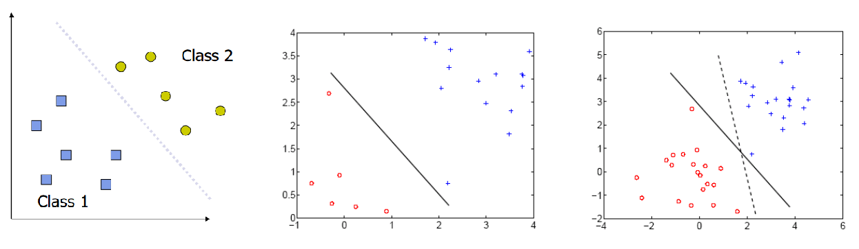
Decision Boundary
If the decision surface is a line/hyperplane, then the classification problem is linear, and the classes are linearly separable.
When the training examples are linearly separable, we can set the parameters of a linear classifier so that all the training examples are classified correctly
Many decision boundaries!

Slide 15
Decision Boundary
Earlier definition of decision boundary (points where classifier gets confused is simple but not general enough)
More robust definition of decision boundary: locations where classifier decision abruptly changes from one class to another class
All classifiers have such a decision boundary
Easy to detect whether a test point is at decision boundary for linear classifiers – difficult to do so for most other classifiers, e.g. deep nets

Slide 16


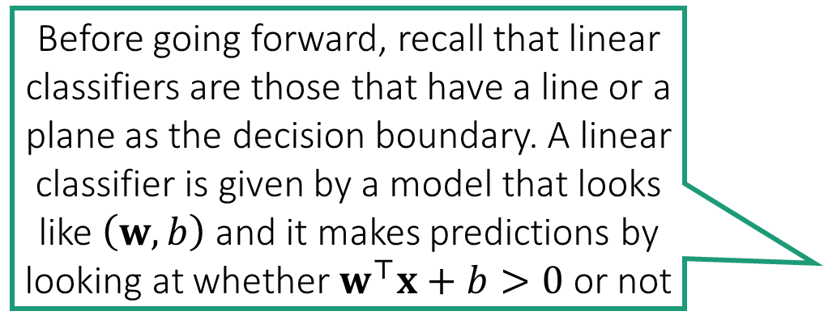
Linear Classifiers
LwP with 2 classes, Euclidean metric always gives a linear classifier
Even if Mahalanobis metric used, still LwP gives a linear classifier
Extremely popular in ML
Very small model size – just one vector (and one bias value)
Very fast $𝒪\left(d\right)$ prediction time
Before going forward, recall that linear classifiers are those that have a line or a plane as the decision boundary. A linear classifier is given by a model that looks like $\left(w,b\right)$ and it makes predictions by looking at whether $w^{⊤}x+b>0$ or not

Slide 17


The “best” Linear Classifier
It seems infinitely many classifiers perfectly classify the data. Which one should I choose?
All these brittle dotted classifiers misclassify the two new test points
However, the bold classifier, whose decision boundary is far from all train points is not affected
Indeed! Such models would be very brittle and might misclassify test data (i.e. predict the wrong class), even those test data which look very similar to train data
It is better to not select a model whose decision boundary passes very close to a training data point

Slide 18
Large Margin Classifiers
Geometric Margin
A good linear classifier would can be one where all data points are correctly classified, as well as far from the hyperplane

Slide 19
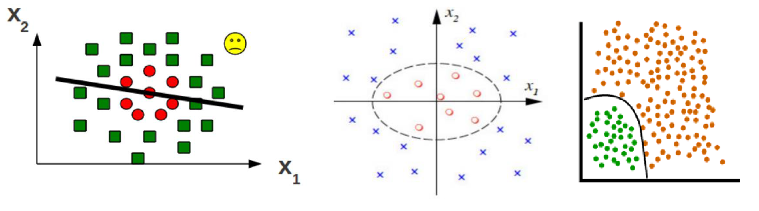
Non-­linear decision boundaries
Non-linear Boundary in Deep Neural Network

Slide 20
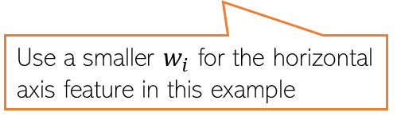
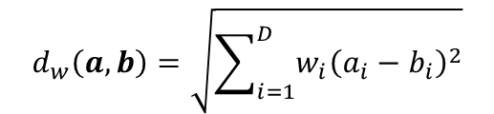






Improving LwP when classes are complex-shaped
Using weighted Euclidean or Mahalanobis distance can sometimes help
Note: Mahalanobis distance also has the effect of rotating the axes which helps
$$d_{w}\left(a,b\right)=\sqrt{\sum_{i=1}^{D}{{w_{i}\left(a_{i}−b_{i}\right)}^{2}}}$$
$$μ_{+}$$
$$μ_{−}$$
Use a smaller $w_{i}$ for the horizontal axis feature in this example
A good W will help bring points from same class closer and move different classes apart
W will be a 2x2 symmetric matrix in this case (chosen by us or learned)
$$μ_{−}$$
$$d_{w}\left(a,b\right)=\sqrt{{\left(a−b\right)}^{⊤}W\left(a−b\right)}$$
$$μ_{+}$$
$$μ_{+}$$
$$μ_{−}$$

Slide 21
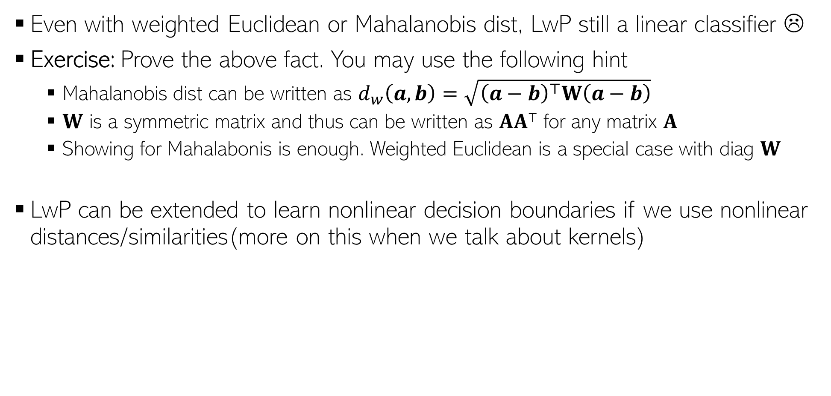
Improving LwP when classes are complex-shaped
Even with weighted Euclidean or Mahalanobis dist, LwP still a linear classifier ☹
Exercise: Prove the above fact. You may use the following hint
Mahalanobis dist can be written as $d_{w}\left(a,b\right)=\sqrt{{\left(a−b\right)}^{⊤}W\left(a−b\right)}$
$W$ is a symmetric matrix and thus can be written as $AA⊤$ for any matrix $A$
Showing for Mahalabonis is enough. Weighted Euclidean is a special case with diag $W$
LwP can be extended to learn nonlinear decision boundaries if we use nonlinear distances/similarities(more on this when we talk about kernels)
Note: Modeling each class by not just a mean but by a probability distribution can also help in learning nonlinear decision boundaries. More on this when we discuss probabilistic models for classification
Notes:
Calculating distance in high dimensional Hilbert space using kernel functions solves non-linear problem in LwP. Apart from it, non-linear distance measure that take data distribution into account and modelling by probability distribution can also help.

Slide 22
LwP as a subroutine in other ML models
For data-clustering (unsupervised learning), K-means clustering is a popular algo
K-means also computes means/centres/prototypes of groups of unlabeled points
Harder than LwP since labels are unknown. But we can do the following
Guess the label of each point, compute means using guess labels
Refine labels using these means (assign each point to the current closest mean)
Repeat until means don’t change anymore
Many other models also use LwP as a subroutine
https://www.youtube.com/watch?v=5I3Ei69I40s
Will see K-means in detail later

Slide 23
Supervised Learning using Nearest Neighbors

Slide 24
Nearest Neighbors
Another supervised learning technique based on computing distances
Very simple idea. Simply do the following at test time
Compute distance of of the test point from all the training points
Sort the distances to find the “nearest” input(s) in training data
Predict the label using majority or avg label of these inputs
Can use Euclidean or other dist (e.g., Mahalanobis). Choice imp just like LwP
Unlike LwP which does prototype based comparison, nearest neighbors method looks at the labels of individual training inputs to make prediction
Applicable to both classifn as well as regression (LwP only works for classifn)
Wait. Did you say distance from ALL the training points? That’s gonna be sooooo expensive! ☹
Yes, but let’s not worry about that at the moment. There are ways to speed up this step

Slide 25
Nearest Neighbors for Classification

Slide 26

Nearest Neighbor (or “One” Nearest Neighbor)
Decision boundary
Interesting. Even with Euclidean distances, it can learn nonlinear decision boundaries?
Indeed. And that’s possible since it is a “local” method (looks at a local neighborhood of the test point to make prediction)
Nearest neighbour approach induces a Voronoi tessellation/partition of the input space (all test points falling in a cell will get the label of the training input in that cell)
Test point
Test point

Slide 27



K Nearest Neighbors (KNN)
In many cases, it helps to look at not one but $K$ > 1 nearest neighbors
Essentially, taking more votes helps!
Also leads to smoother decision boundaries (less chances of overfitting on training data)
$K$ = 1
Test input
$K$ = 3
How to pick the “right” K value?
K is this model’s “hyperparameter”. One way to choose it is using “cross-validation” (will see shortly)
A hyperparameter is a parameter whose value is used to control the learning process.
Also, K should ideally be an odd number to avoid ties

Slide 28
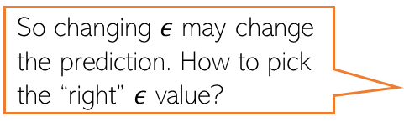
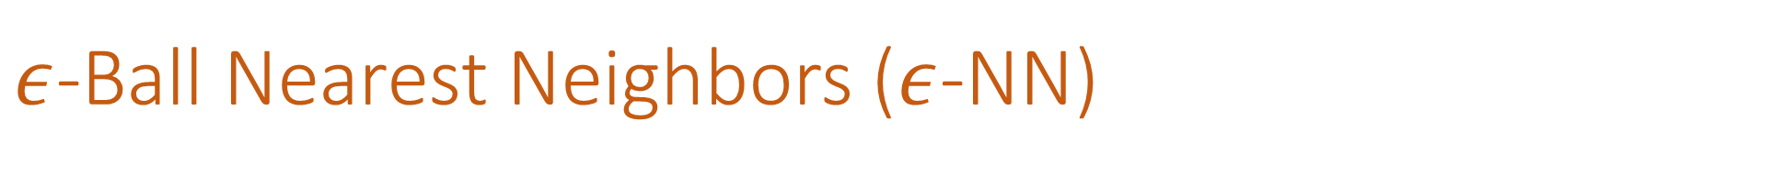

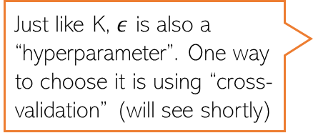
$ε$-Ball Nearest Neighbors ($ε$-NN)
Rather than looking at a fixed number $K$ of neighbors, can look inside a ball of a given radius $ε$, around the test input
So changing $ε$ may change the prediction. How to pick the “right” $ε$ value?
Test input
Just like K, $ε$ is also a “hyperparameter”. One way to choose it is using “cross-validation” (will see shortly)

Slide 29







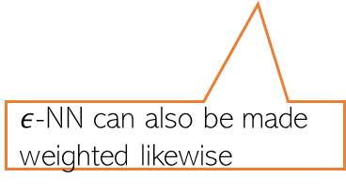
Distance-weighted KNN and $ε$-NN
The standard KNN and 𝜖-NN treat all nearest neighbors equally (all vote equally)
An improvement: When voting, give more importance to closer training inputs
$K$ = 3
Test input
$$\frac{1}{3}$$
+
$$\frac{1}{3}$$
+
$$\frac{1}{3}$$
=
In weighted approach, a single red training input is being given 3 times more importance than the other two green inputs since it is sort of “three times” closer to the test input than the other two green inputs
Unweighted KNN prediction:
$$\frac{3}{5}$$
+
$$\frac{1}{5}$$
+
$$\frac{1}{5}$$
=
Weighted KNN prediction:
$ε$-NN can also be made weighted likewise

Slide 30
KNN/$ε$-NN for Other Supervised Learning Problems
Can apply KNN/𝜖-NN for other supervised learning problems as well, such as
Multi-class classification
Regression
Tagging/multi-label learning
For multi-class, simply used the same majority rule like in binary classfn case
Just a simple difference that now we have more than 2 classes
For regression, simply compute the average of the outputs of nearest neighbors
For multi-label learning, each output is a binary vector (presence/absence of tag)
Just compute the average of the binary vectors
Result won’t be a binary vector but we can report the best tags based on magnitudes
We can also try the weighted versions for such problems, just like we did in the case of binary classification

Slide 31

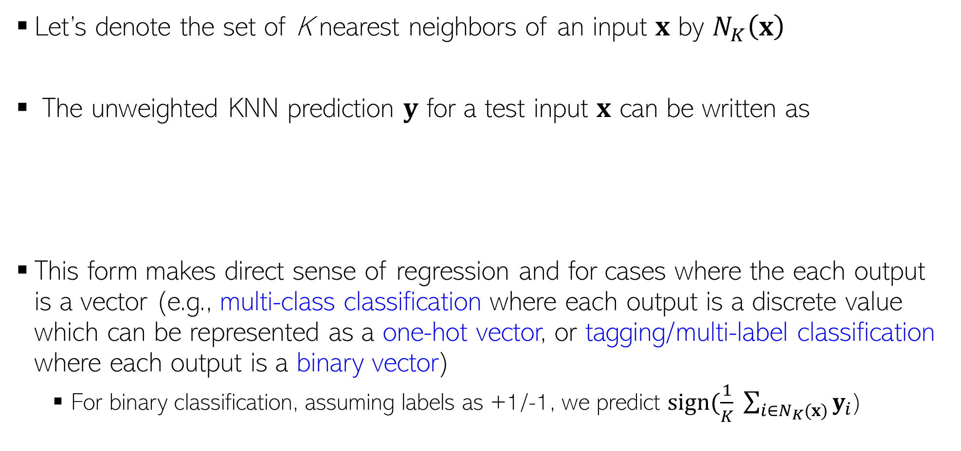
KNN Prediction Rule: The Mathematical Form
Let’s denote the set of K nearest neighbors of an input $x$ by $N_{K}\left(x\right)$
The unweighted KNN prediction $y$ for a test input $x$ can be written as
This form makes direct sense of regression and for cases where the each output is a vector (e.g., multi-class classification where each output is a discrete value which can be represented as a one-hot vector, or tagging/multi-label classification where each output is a binary vector)
For binary classification, assuming labels as +1/-1, we predict $sign(\frac{1}{K} \sum_{i∈N_{K}(x)}{y_{i}}$)
Assuming discrete labels with 5 possible values, the one-hot representation will be a all zeros vector of size 5, except a single 1 denoting the value of the discrete label, e.g., if label = 3 then one-hot vector = [0,0,1,0,0]
$$y= \frac{1}{K} \sum_{i∈N_{K}(x)}{y_{i}}$$

Slide 32
Nearest Neighbors: Some Comments
An old, classic but still very widely used algorithm
Can sometimes give deep neural networks a run for their money ☺
Can work very well in practical with the right distance function
Comes with very nice theoretical guarantees
Also called a memory-based or instance-based or non-parametric method
No “model” is learned here (unlike LwP). Prediction step uses all the training data
Requires lots of storage (need to keep all the training data at test time)
Prediction step can be slow at test time
For each test point, need to compute its distance from all the training points
Clever data-structures or data-summarization techniques can provide speed-ups

